Slide 1
Perception and Individual Decision Making

Slide 2
Perception
Perception is a process by which individuals organize and interpret their impressions in order to give meaning to their environment.

Slide 3
Influence of perception on managerial tasks
Employee Interview
Performance Expectations
Performance Evaluation

Slide 4
Shortcuts in judging others
Halo Effect
impression on the basis of a single characteristic.

Slide 5
Shortcuts in judging others
Contrast Effects
Comparing with recently encountered person

Slide 6
Shortcuts in judging others
Stereotyping
on the basis of one’s perception of the group

Slide 7
Attribution
Attribution: looking for an explanation of another person’s behavior.
Internal vs. external

Slide 8
Attribution
Fundamental Attribution Error:
Tendency to underestimate the influence of external factors and overestimate the influence of internal factors when making judgments about the behavior of others
Self Serving Bias :
The tendency for individuals to attribute their own successes to internal factors and put the blame for failures on external factors

Slide 9
Attribution Theory
Three determinants:
Distinctiveness: in different situations
Consensus: others’ behavior
Consistency: in same situations

Slide 10
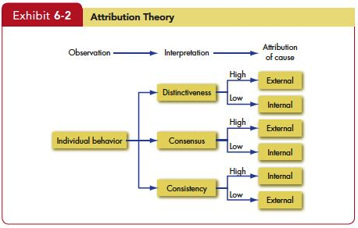
Explain attribution theory and list the three determinants of attribution

Slide 11
Shortcuts in judging others
How to decrease biases and errors?

Slide 12
Shortcuts in judging others
How to decrease biases and errors?
Managers need to understand they are influenced by many biases
Systems to overcome biases
Interview:
Personal interview, Group interview, situational play, etc.
Performance evaluation:
360 evaluation

Slide 13
Decision-Making
Decision – choices made from among two or more alternatives
Decisions in organizations
E.g., Hiring, strategy, product development, etc.
Biases and errors

Slide 14
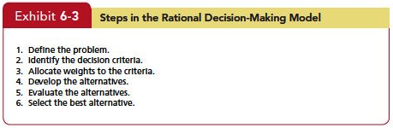
Rational Decision Making

Slide 15
Bounded Rationality
Simplified criteria
Limited List
Pick “good enough” one

Slide 16
Decision Biases and Errors

Slide 17
Decision Biases and Errors
Overconfidence Bias
Overestimating performance and ability.
Confirmation Bias
Seeking out information affirming past choices
Escalation of Commitment
Staying with a decision (even it is wrong)
Sunk cost

Slide 18
Decision Biases and Errors
Availability Bias
Influence of readily available information
Anchoring Bias
Influence of initial information
Randomness Error
Creating meaning out of random events.

Slide 19
Decision Biases and Errors
Risk Aversion
Sticking with the established way
Sure gain of a moderate amount over a riskier outcome, even if the riskier outcome have a higher expected payoff
Hindsight Bias
False belief about accurate prediction in the past

Slide 20
Individual differences affecting decision-making
Individual Differences
Personality
Achievement oriented
Escalation of commitment
Hindsight bias
High self-esteem
Self-serving bias
Gender
Rumination: overthinking problem
Mental Ability
Smart people learn how to avoid errors quickly

Slide 21
Organizational constraints affecting decision-making
Organizational Constraints
Performance Evaluations
Deadlines
Reward Systems
Historical Precedents

Slide 22
Reducing biases and errors
Focus on goals
Information that disconfirms your beliefs
Don’t try to create meaning out of random events
Increase your options

Slide 23
Managerial Implications
Be aware of biases. Then try to minimize their impact.
Assess how your employees perceive their jobs and clear up any perceptual distortions

